Slide 1
Movie Recommendation System
Flick Insights
2021/22 Climate Change Believe Analysis
Predict an individual sentiment on climate change based on historical tweet data

Slide 2

Flick Insights
Flick Insights is a software as a service(saas) platform used by Cinemas and movie streaming platform as a recommendation engine, to recommend movies to their customers
New user can choose 3 Movies of their choice and Flick Insights will request an API Call to recommend Top 10 movies that matches user preference with a high similarity score.
For regular users, the API model makes recommendations based on users data and the IMDb metadata.

Slide 3
Understanding Problem Statement
Missing Values
Unlimited Supply of Content
Increased Customer Churn
Low Customer Satisfaction
Time and Cost
Inefficency

Slide 4
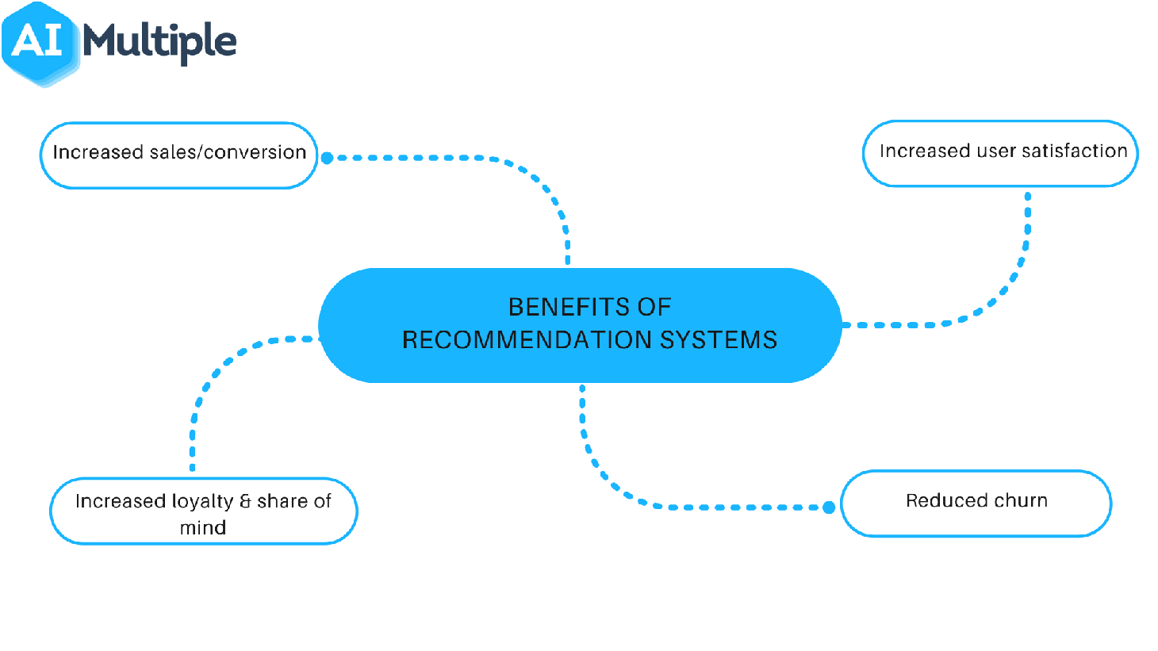
Benefits of using Flick Insights

Slide 5
Benefits of using Flick Insights
During movie night-out/at the cinema –A group of friends or family can enter a list of their most liked movies into the Self-Service portal at the cinema
The platform will then use Flick Insights API call recommend movies that the user/users will probably like based on the metrics
Increased Sales and conversion due to increased customer retention
Increased customer satisfaction and new customer attraction due to peer to peer marketing
Reduced churn, there will be a decrease in number of customers who stop using the product
Increase customer traffic and loyalty

Slide 6


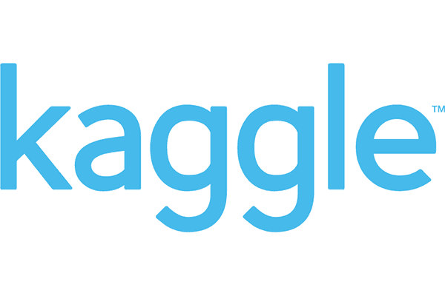




Machine Learning
Lifecycle
Data
Preprocessing
TRAIN/
Evaluate
Business
Problem
Data
Collection
Data
Engineering
Hyper-Parameter
Tuning
Data
Exploration (EDA)
Data
Visualization
TEST/
Evaluate
Recommender
System
Model
Deployment
Streamlit
Application

Slide 7
Recommender System
Lifecycle
Data Preprocessing
Hyperparameter Tuning
Data Exploration (EDA)
Data Engineering
Model & Evaluate
Visualizing
Model Performance
Data Visualization
Feature Analysis
Merging Features
Extract Timestamp
Vectorizing
Scaling
Model Evaluation

Slide 8
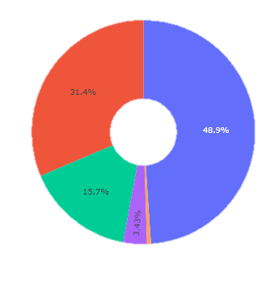
Exploring our Dataset size
train
genome_score
test
tags

Slide 9
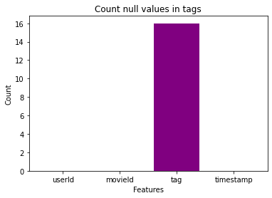
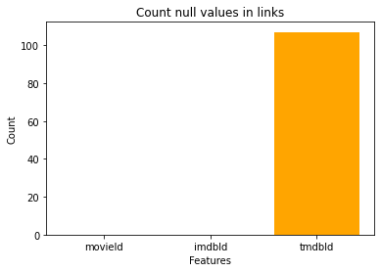
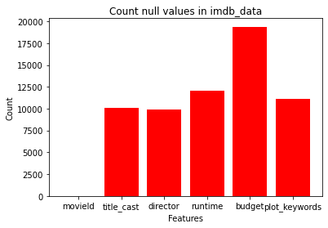
Analysing Null Values from the Dataset

Slide 10
Distribution of Movies Ratings
2.5M
2.0M
1.5M
Count
1.0M
0.5M
0
1.0 2.0 3.0 4.0 5.0
Ratings

Slide 11
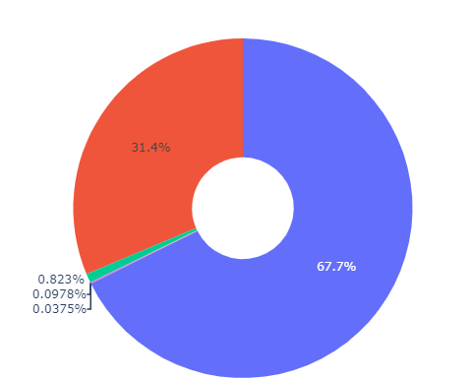
Grouped Ratings By UserId Distribution
Second Group: 50973
(50 - 500)
First Group : 110010
(1 - 50)
Third Group: 1338
(500 - 1000 )
Fourth Group: 159
(1000 - 1500 )
Fifth Group: 61
( > 1500 )

Slide 12
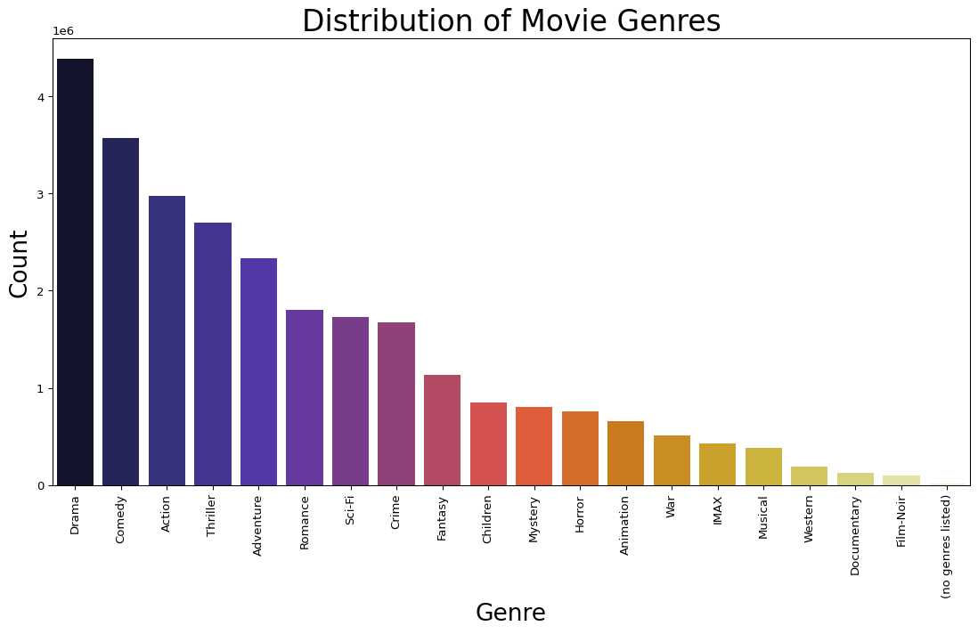
Distribution of Movie Genre

Slide 13
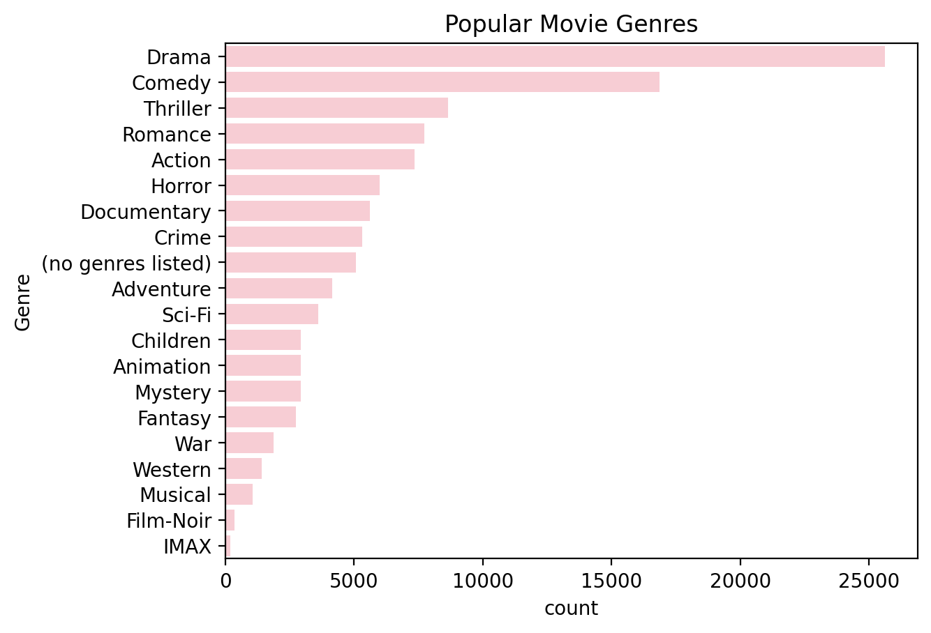
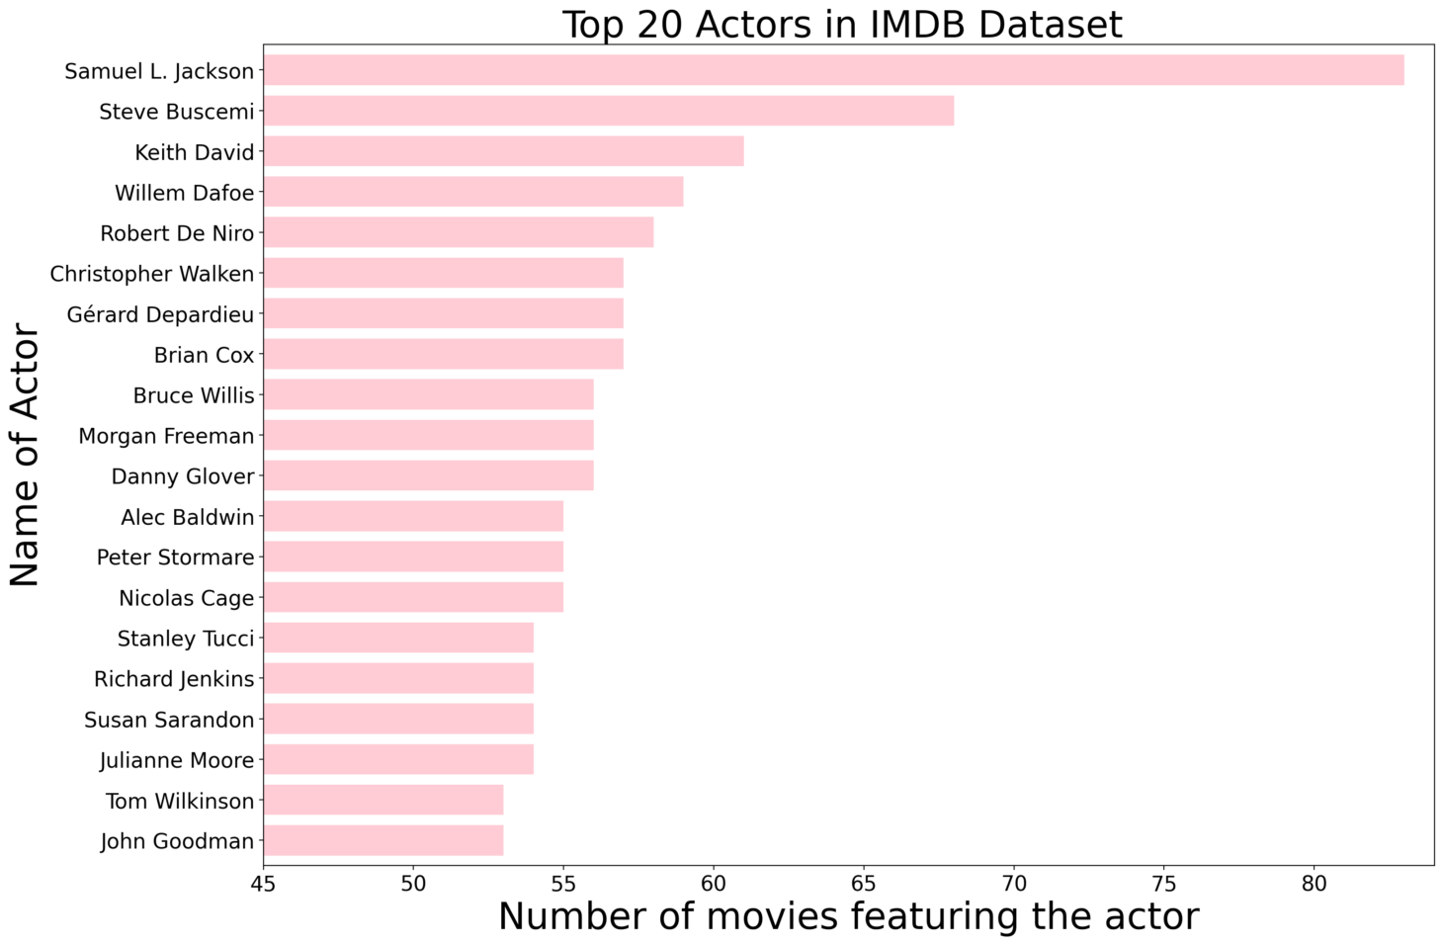
Analysing Popular Movie Genres
Analysing Popular Movie Actors

Slide 14
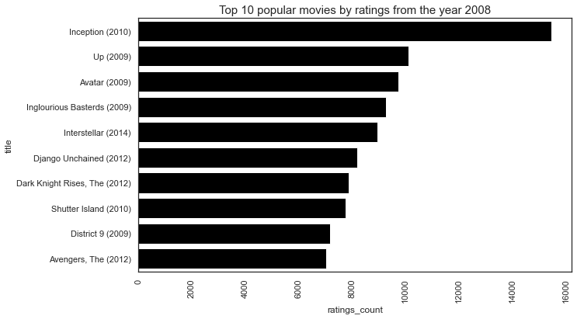
Analysing Popular Movies in 2008

Slide 15
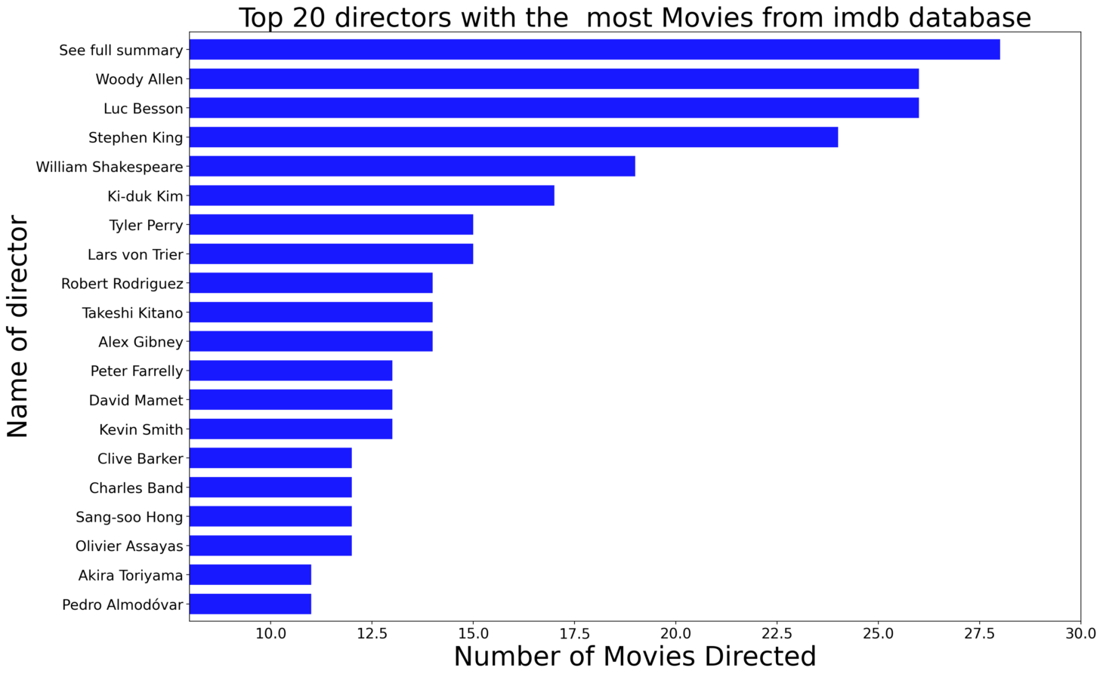
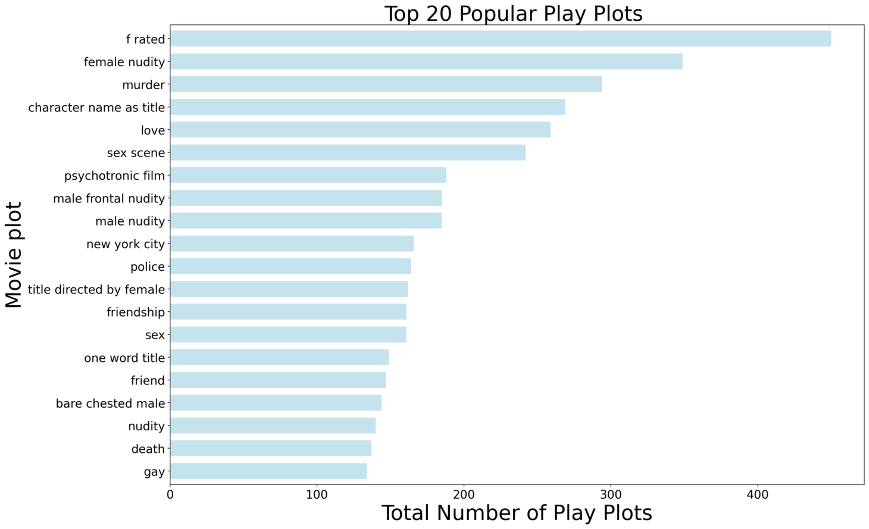
Analysing Popular Directors
Analysing Popular Plots

Slide 16
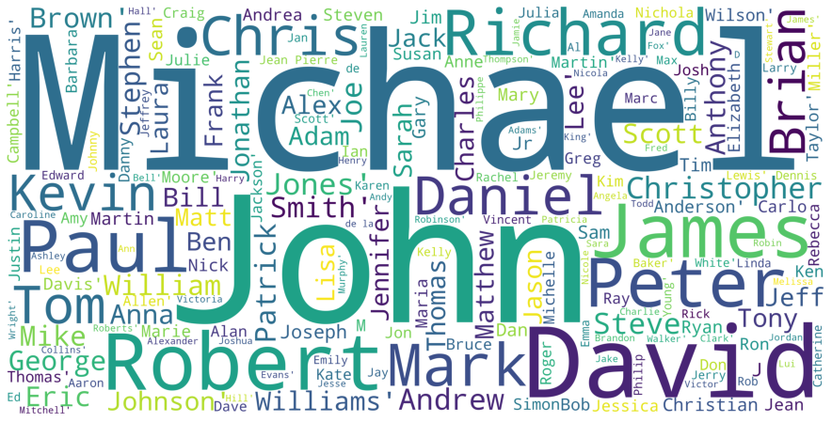
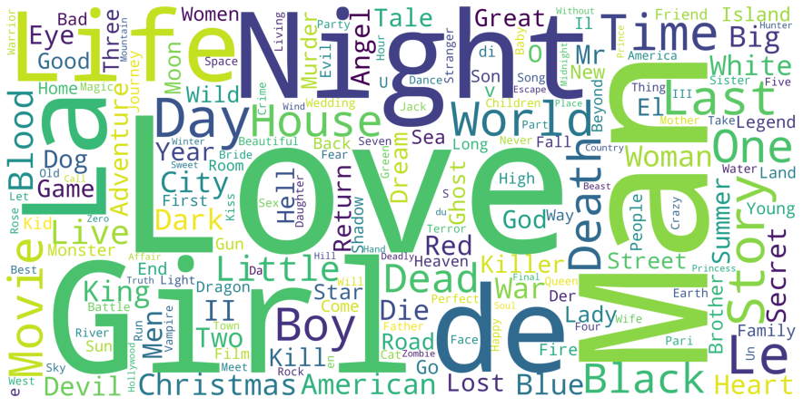
Further Tag Exploration using word-cloud
Common Casts Name Movie Titles

Slide 17
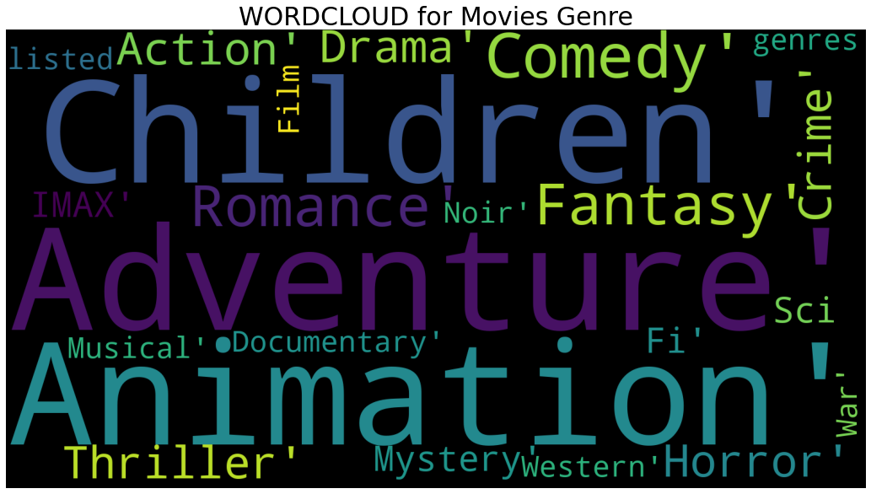
Movie Genres

Slide 18
Data Engineering
Vectorizing
Data
Scaling
Train Test Split

Slide 19
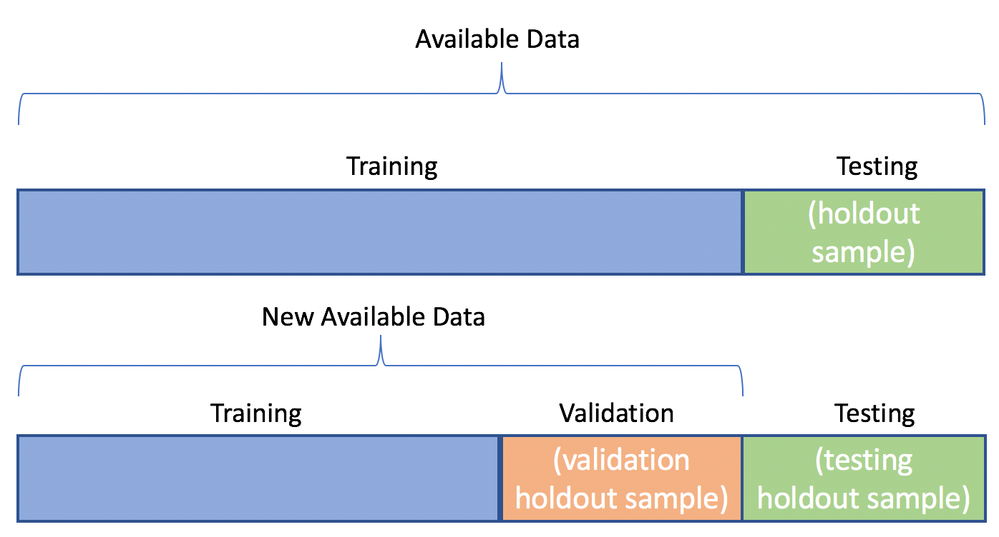
Train Test Split

Slide 20
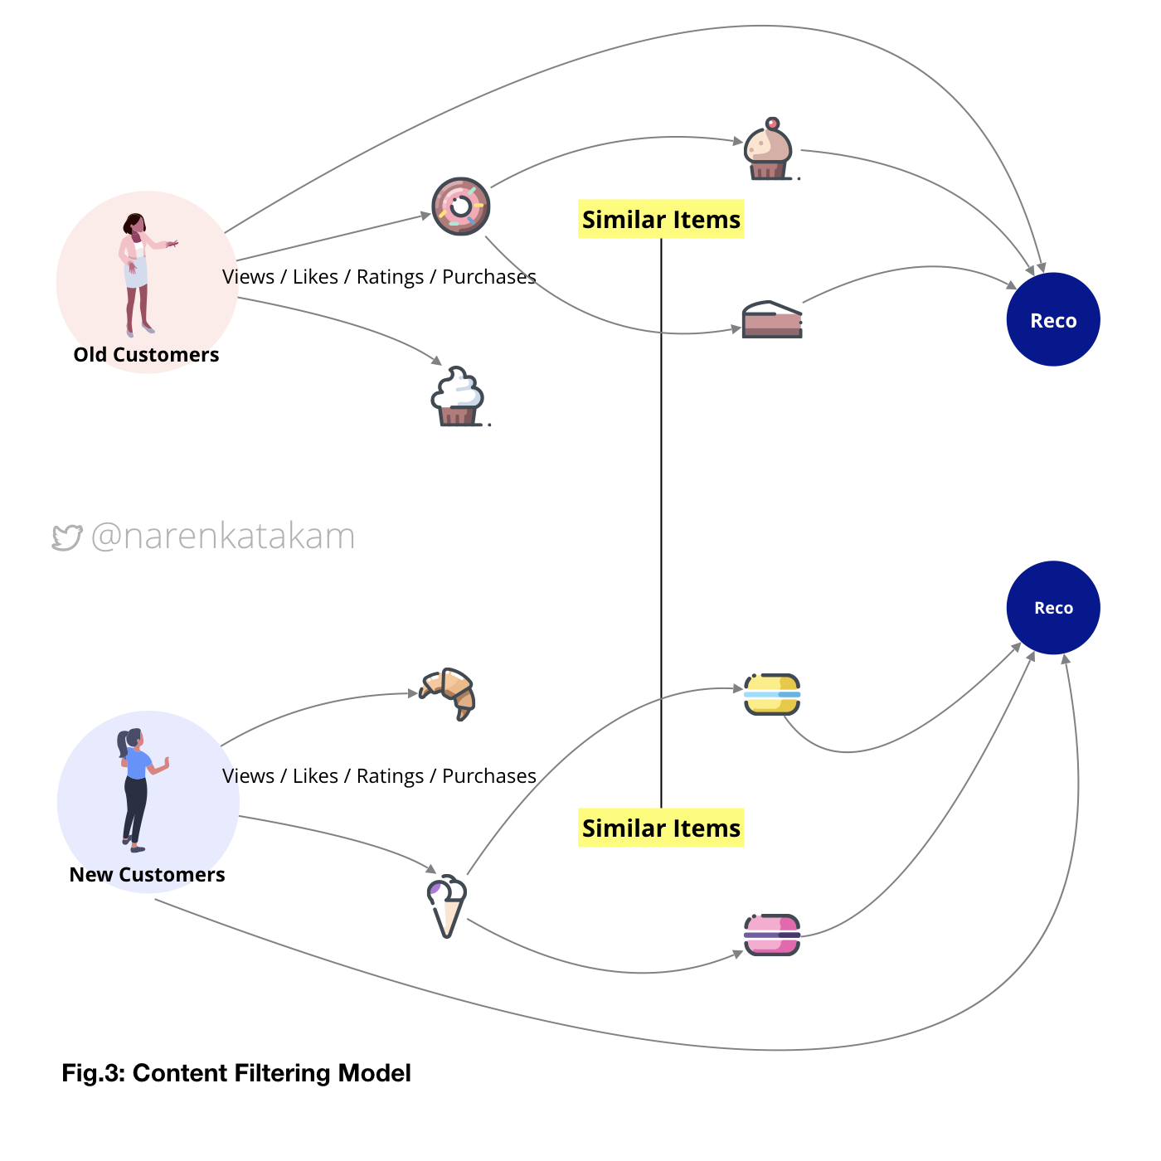
Content Filtering Model

Slide 21
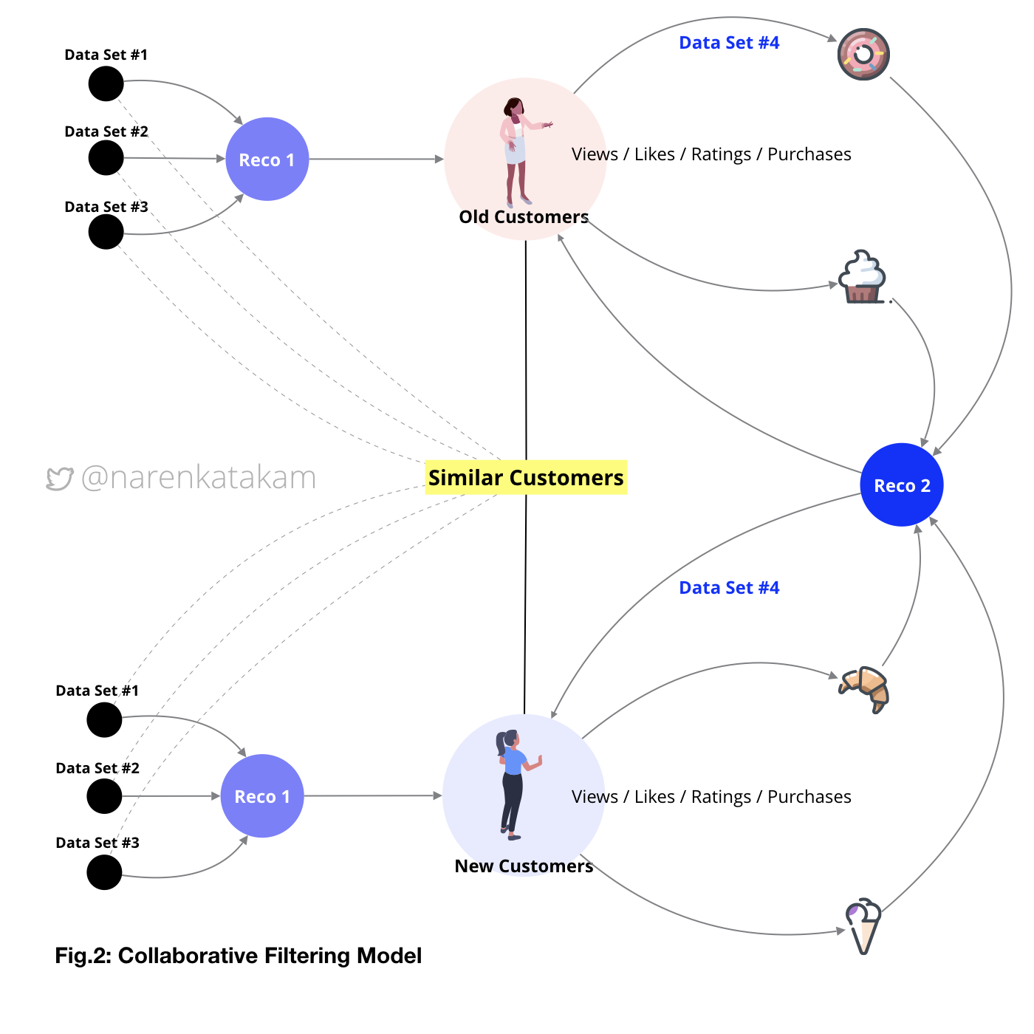
Collaborative Filtering Model

Slide 22
Modelling

Slide 23
Best model with low RMSE score
1.0
Algo: SVD
RMSE: 0.847470
0.84
0.7
RMSE
0.6
0.5
0
SVD
BaselineOnly
KNNWithMeans
KNNBaseLine
Algorithms

Slide 24
Singular Value Decomposition
SVD is a matrix factorisation technique, which reduces the number of features of a dataset by reducing the space dimension from N-dimension to K-dimension (where K<N).
In the context of the recommender system, the SVD is used as a collaborative filtering technique.
It uses a matrix structure where each row represents a user, and each column represents an item. The elements of this matrix are the ratings that are given to items by users.

Slide 25
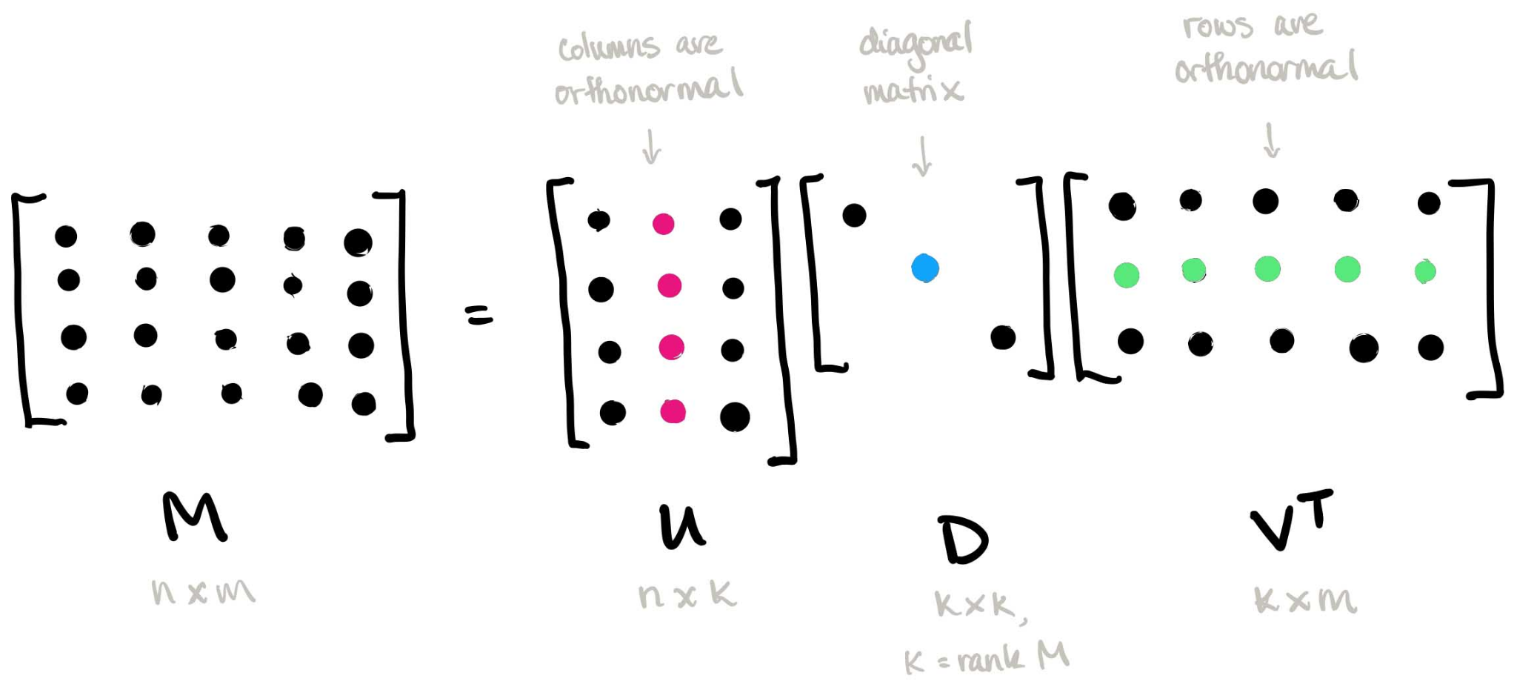
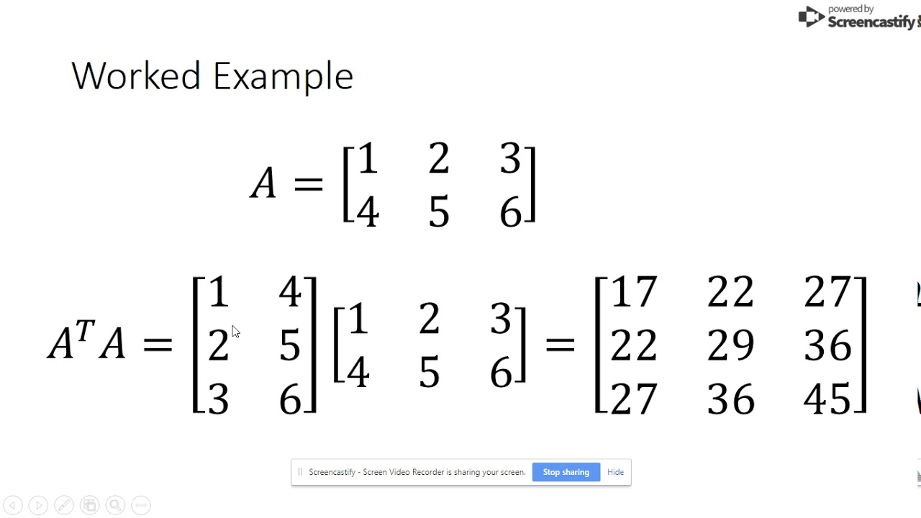
Singular Value Decomposition(SVD)

Slide 26
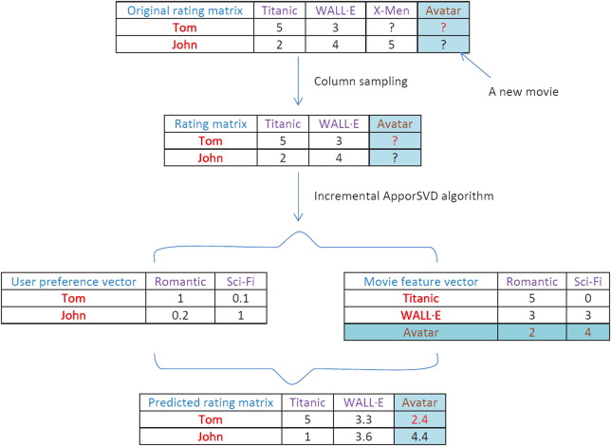

Slide 27
SVD++ LibRecommender
The SVDpp from LibReccomender seems very robust, the more epochs we give it the better the test set RMSE.
Algo: SVD++
RMSE: 0.798
Epoch: 8
Execution Time: 15min (10min Google Colab)

Slide 28
Conclussion

Slide 29


